Slide 1

DATABASE MANAGEMENT SYSTEM
SOFTWARE MANAGEMENT SYSTEM
Department of COMPUTER SCIENCE AND ENGINEERING
Presented By:
G. Kushal
S. Abhishek
M. Shankar
S.K Zhuwao

Slide 2

PROBLEM STATEMENT:
• Managing software information manually can be time-consuming and difficult.
• Maintaining software, user, and license records manually may lead to errors.
• Checking software availability and license status can be difficult.
• Managing software purchases, licenses, installations, and renewals requires proper record keeping.
• Searching and updating software information manually takes more time.
• There is a need for a centralized database to store and manage all software-related information efficiently.
PROPOSED SOLUTION:
• The Software Management System provides a centralized database to manage software products, users, licenses, vendors, installations, and purchase information in an organized and efficient manner.

Slide 3
WHY IS THE SYSTEM NEEDED?
• To reduce manual work in software management.
• To maintain software and user information in one place.
• To quickly check software and license availability.
• To manage software licenses efficiently.
• To maintain accurate purchase and renewal records.
• To reduce data duplication and human errors.
• To provide faster access to software information.

Slide 4
OBJECTIVES:
The main objectives of the Software Management System are:
To store and manage software details securely.
To maintain complete information about software products.
To manage software licenses and installations.
To track license availability and status.
To maintain vendor and purchase information.
To track license renewal and expiry dates.
To reduce manual work and data-entry errors.
To provide quick and organized access to software records.

Slide 5
FUNCTIONAL REQUIREMENTS:
What the system does.
Add software
Update software
Delete software
View software
Register users
Manage licenses
Manage vendors
Record installations
Record purchases
Track license expiry
Search software information

Slide 6
NON-FUNCTIONAL REQUIREMENTS:
The system should provide:
• Security: Protect software, license, and user information from unauthorized access.
• Performance: Retrieve and update records quickly.
• Reliability: Maintain accurate and consistent software data.
• Usability: Provide a simple and user-friendly interface.
• Scalability: Allow the database to handle more software, users, and licenses in the future.
• Data Integrity: Ensure that stored information remains accurate and consistent.
• Availability: Make the system available whenever software information is required.

Slide 7
END USERS
.
1. ADMINISTRATOR
• Manages the complete system.
• Adds and updates software information.
• Manages users and software licenses.
• Monitors purchases and renewals.
2. IT STAFF
• Registers software.
• Manages software installations.
• Checks license availability.
• Records license renewals and updates.
3. USER / EMPLOYEE
• Provides personal details for registration.
• Views available software.
• Requests software access.
• Uses assigned software.

Slide 8
ER DESIGN:
• The Entity-Relationship (ER) model represents the structure of the Software Management System.
• It identifies:
• Entities – Objects involved in the system.
• Attributes – Properties that describe each entity.
• Primary Keys – Uniquely identify each record.
• Relationships – Show how entities are connected.
• Cardinality – Defines how many records of one entity can be associated with another entity.

Slide 9
MAIN ENTITIES:
The main entities in our ER diagram are:
EMPLOYEE
MANAGER
PROJECT
TASK
MODULE
CLIENT

Slide 10
ENTITIES AND ATTRIBUTES:
Entity | Primary Key | Main Attributes
EMPLOYEE | Emp_ID | Emp_Name, Email, Phone_No, Hire_Date, Address
MANAGER | Manager_ID | Manager_Name, Email, Phone_No
PROJECT | Project_ID | Project_Name, Start_Date, End_Date, Technologies, Budget
TASK | Task_ID | Task_Name, Description, Priority
MODULE | Module_ID | Module_Name, Version, Feature
CLIENT | Client_ID | Client_Name, Contact_Details

Slide 11
RELATIONSHIPS & CARDINALITIES
RELATIONSHIPS & CARDINALITIES
RELATIONSHIPSRELATIONSHIPS & CARDINALITIES
& CARDINALITIES
RELATIONSHIPS & CARDINALITIES
Relationship | Entities Involved | Cardinality
WORKS_ON | Employee – Project | M : N
REPORTS_TO | Employee – Manager | M : 1
ASSIGNED_TO | Employee – Project – Task | Ternary
DEVELOPS | Project – Module | 1 : M
DEPENDS_ON | Task – Task | M : N
MAINTAINS | Client – Module | 1 : M

Slide 12
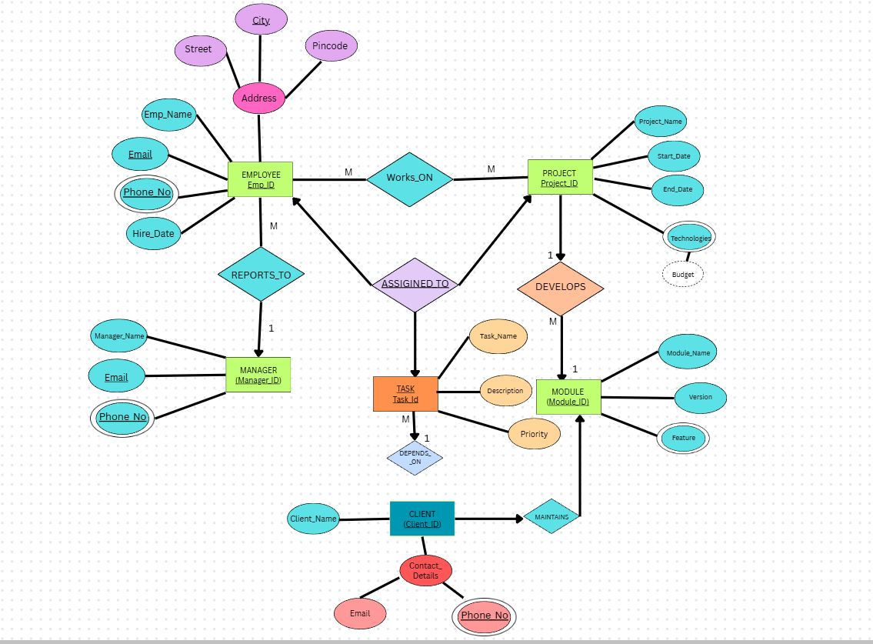
ER DIAGRAM
SOFTWARE MANAGEMENT SYSTEM

Slide 13
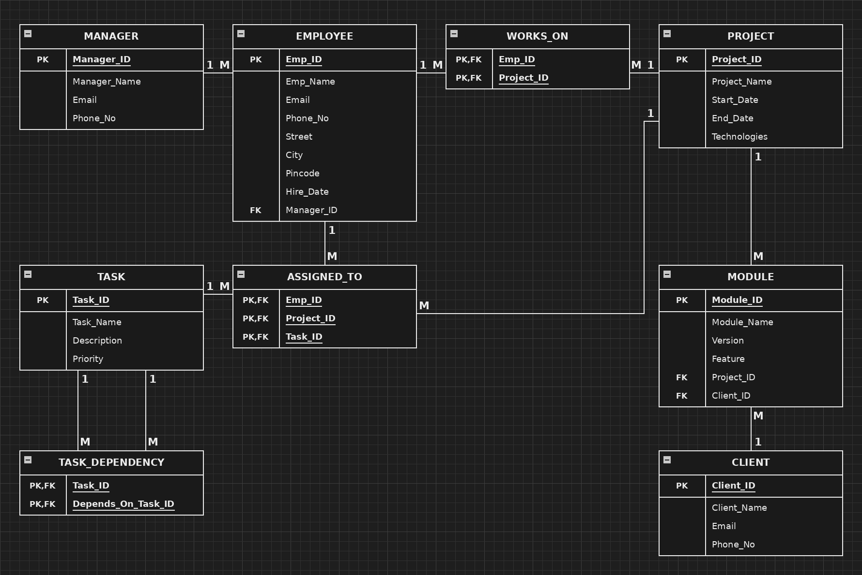
RELATIONAL SCHEMA

Slide 14
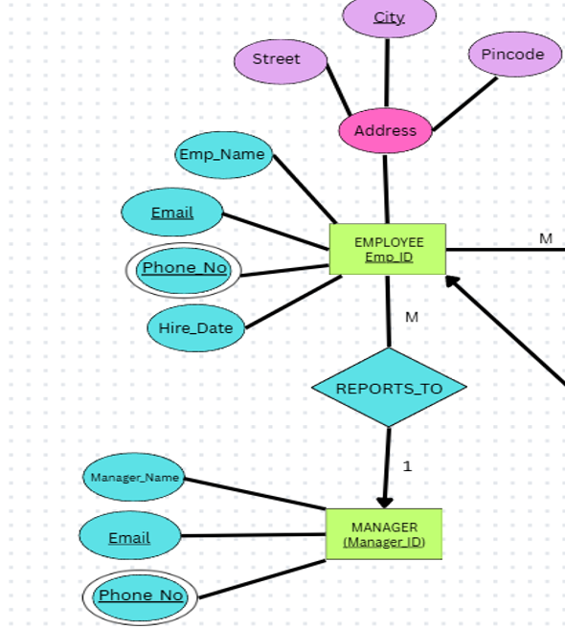
EMPLOYEE TABLE
CREATE TABLE EMPLOYEE (
Emp_ID NUMBER(5) PRIMARY KEY,
Emp_Name VARCHAR2(50) NOT NULL,
Email VARCHAR2(100) UNIQUE NOT NULL,
Phone_No VARCHAR2(15) UNIQUE NOT NULL,
Street VARCHAR2(100),
City VARCHAR2(50),
Pincode VARCHAR2(10),
Hire_Date DATE NOT NULL,
Manager_ID NUMBER(5),
CONSTRAINT fk_emp_manager
FOREIGN KEY (Manager_ID)
REFERENCES MANAGER(MANAGER(Manager_ID) );

Slide 15
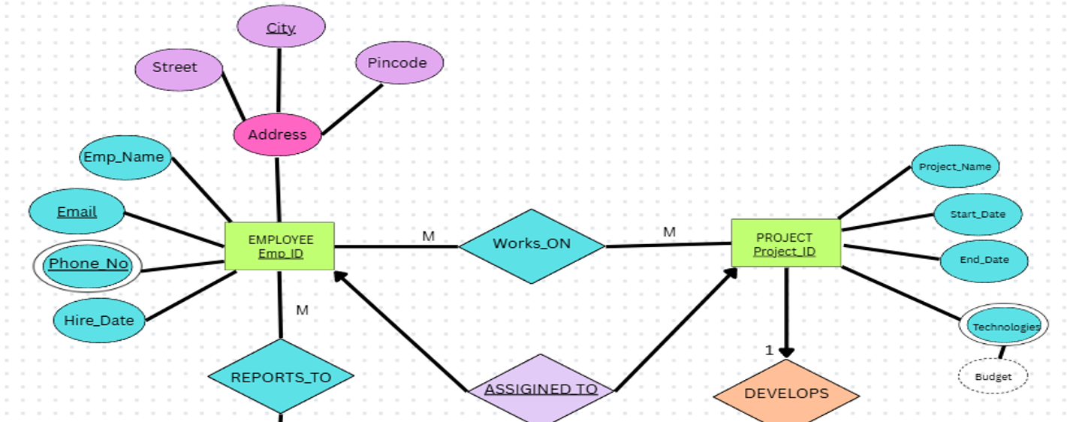
PROJECT TABLE
CREATE TABLE PROJECT (
Project_ID NUMBER(5) PRIMARY KEY,
Project_Name VARCHAR2(100) NOT NULL,
Start_Date DATE NOT NULL,
End_Date DATE,
Technologies VARCHAR2(200),
CONSTRAINT chk_project_dates
CHECK (End_Date IS NULL OR End_Date >= Start_Date)
);

Slide 16
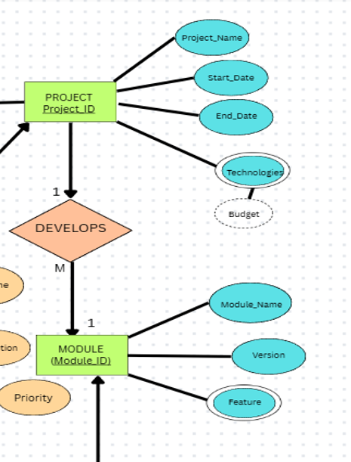
MODULE TABLE
`CREATE TABLE MODULE (
Module_ID NUMBER(5) PRIMARY KEY,
Module_Name VARCHAR2(100) NOT NULL,
Version VARCHAR2(20) NOT NULL,
Feature VARCHAR2(255),
Project_ID NUMBER(5) NOT NULL,
CONSTRAINT fk_module_project
FOREIGN KEY (Project_ID)
REFERENCES PROJECT(Project_ID)
);

Slide 17
MANAGER TABLE
CREATE TABLE MANAGER (
Manager_ID NUMBER(5) PRIMARY KEY,
Manager_Name VARCHAR2(50) NOT NULL,
Email VARCHAR2(100) UNIQUE NOT NULL,
Phone_No VARCHAR2(15) UNIQUE NOT NULL
);

Slide 18
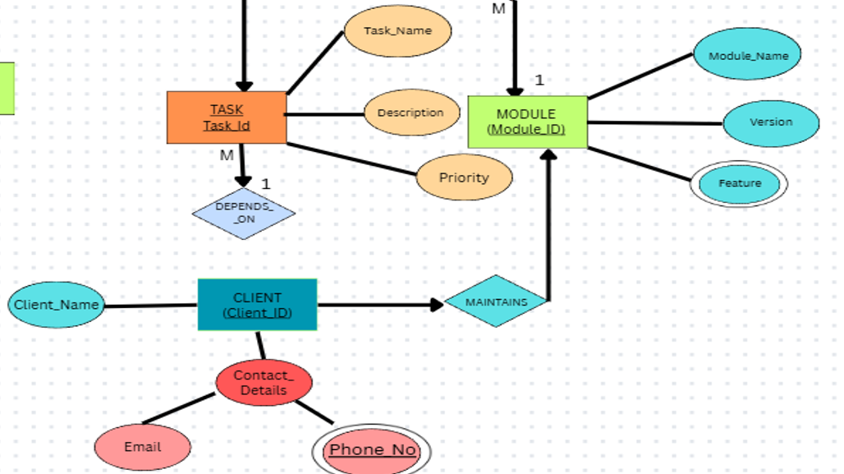
CLIENT TABLE
CREATE TABLE CLIENT (
Client_ID NUMBER(5) PRIMARY KEY,
Client_Name VARCHAR2(100) NOT NULL,
Email VARCHAR2(100) UNIQUE NOT NULL,
Phone_No VARCHAR2(15) UNIQUE NOT NULL
);

Slide 19
TASK TABLE
CREATE TABLE TASK (
Task_ID NUMBER(5) PRIMARY KEY,
Task_Name VARCHAR2(100) NOT NULL,
Description VARCHAR2(255),
Priority VARCHAR2(20),
CONSTRAINT chk_task_priority
CHECK (Priority IN ('High', 'Medium', 'Low'))
);

Slide 20
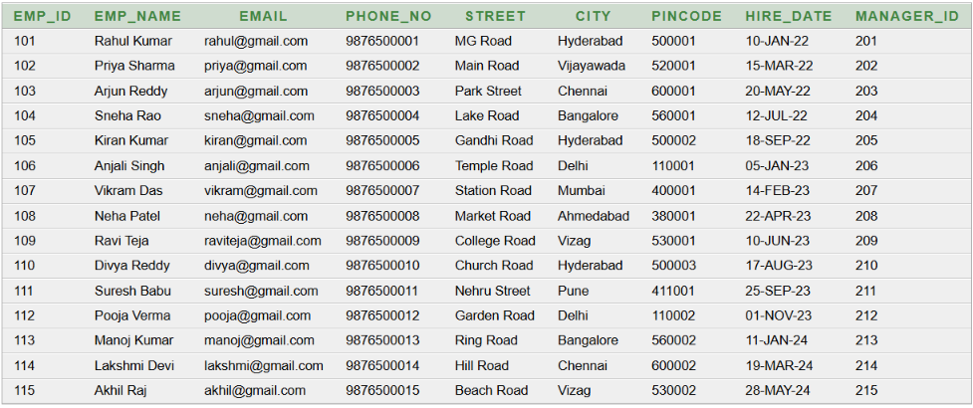
SELECT * FROM EMPLOYEE

Slide 21
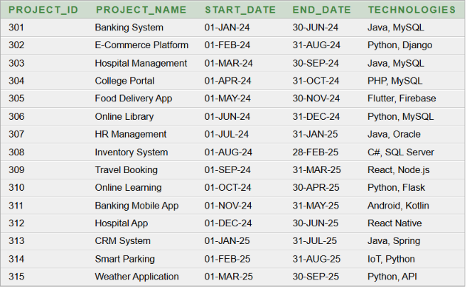
SELECT * FROM PROJECT

Slide 22
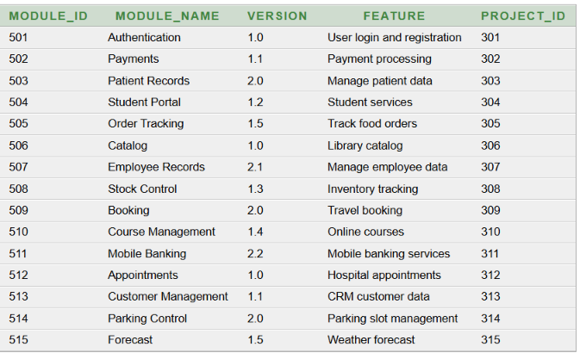
SELECT * FROM MODULE

Slide 23
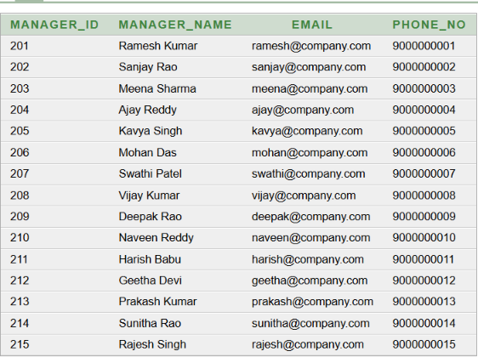
SELECT * FROM MANAGER

Slide 24
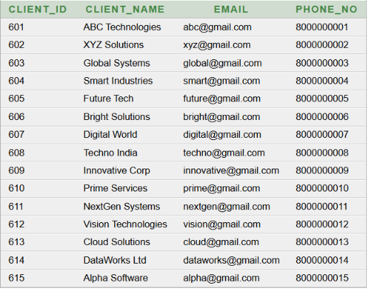
SELECT * FROM CLIENT

Slide 25
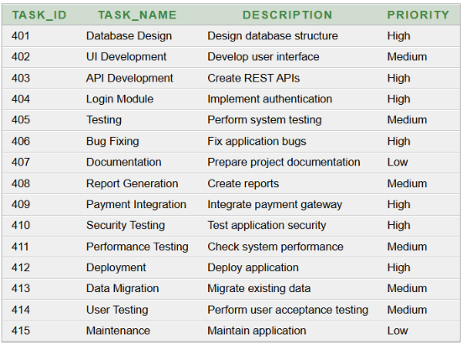
SELECT * FROM TASK

Slide 26
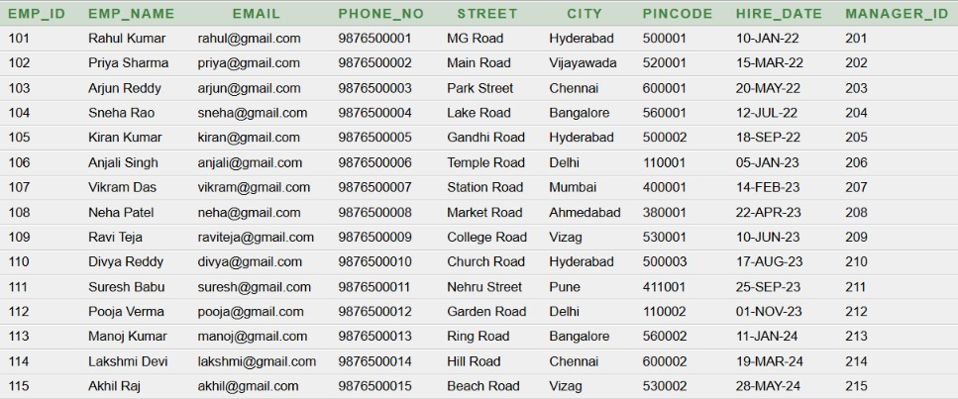
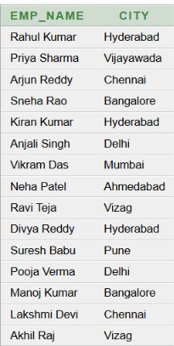
QUERIES
2 .Display the names and cities of all employees.
1 .Display all employees from the Employee table.
SELECT * FROM EMPLOYEE;
SELECT Emp_Name, City
FROM EMPLOYEE;
Output:
Output:

Slide 27
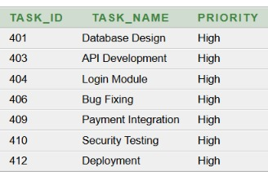
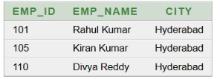
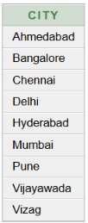
4 . Display all tasks that have high-priority.
3 . Find the employees who are from Hyderabad.
SELECT Task_ID, Task_Name, Priority
FROM TASK
WHERE Priority = 'High';
SELECT Emp_ID, Emp_Name, City
FROM EMPLOYEE
WHERE City = 'Hyderabad';
5. Display all distinct cities in which employee
live,in alphabetical order.
SELECT DISTINCT City
FROM EMPLOYEE
ORDER BY City;

Slide 28

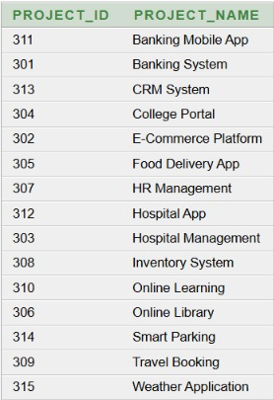
7 .Find the total number of employees in the
Employee table.
6 . Display all projects in alphabetical order
according to the project name.
SELECT Project_ID, Project_Name
FROM PROJECT
ORDER BY Project_Name;
SELECT COUNT(*) AS Total_Employees
FROM EMPLOYEE;

Slide 29
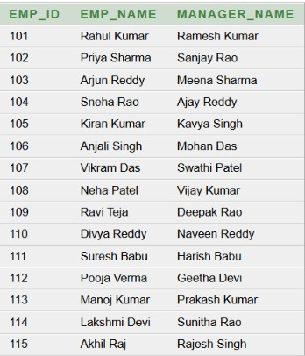
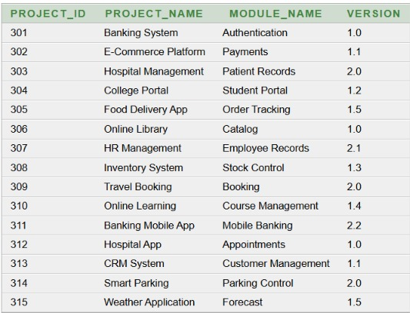
9 .Display each project along with the modules
Developed for that project,including module
version.
8 . Display each Employees along with their managers.
SELECT E.Emp_ID,
E.Emp_Name,
M.Manager_Name
FROM EMPLOYEE E
JOIN MANAGER M
ON E.Manager_ID = M.Manager_ID
ORDER BY E.Emp_ID;
SELECT P.Project_ID,
P.Project_Name,
M.Module_Name,
M.Version
FROM PROJECT P
JOIN MODULE M
ON P.Project_ID = M.Project_ID
ORDER BY P.Project_ID;

Slide 30
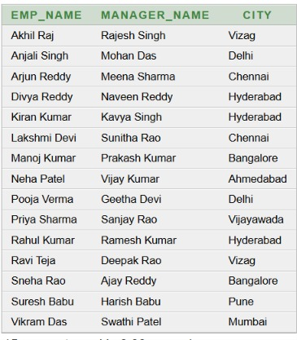
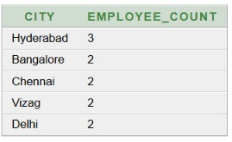
11.Find the number of employees in each city and
Display only cities having more than one employee.
10.Display Employees name,manager name, and employee
City by joining Employee and Manager tables.
SELECT E.Emp_Name,
M.Manager_Name,
E.City
FROM EMPLOYEE E
JOIN MANAGER M
ON E.Manager_ID = M.Manager_ID
ORDER BY E.Emp_Name;
SELECT City,
COUNT(*) AS Employee_Count
FROM EMPLOYEE
GROUP BY City
HAVING COUNT(*) > 1
ORDER BY Employee_Count DESC;

Slide 31
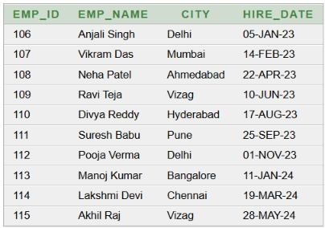

13.Find task priorities that have more than 2 tasks.
12.Display employees who were hired after
January 1, 2023
SELECT Emp_ID,
Emp_Name,
City,
Hire_Date
FROM EMPLOYEE
WHERE Hire_Date > DATE '2023-01-01'
ORDER BY Hire_Date;
SELECT Priority,
COUNT(*) AS Task_Count
FROM TASK
GROUP BY Priority
HAVING COUNT(*) > 2
ORDER BY Task_Count DESC;

Slide 32
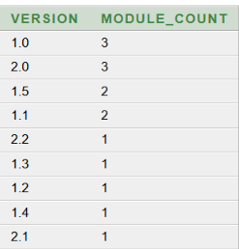
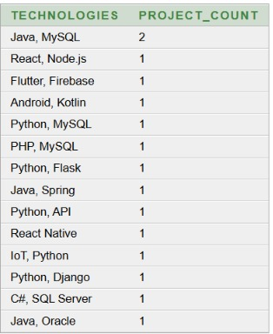
15.Find the number of projects using each
Technology.
14.Find the number of modules available for each
Module version.
SELECT Technologies,
COUNT(*) AS Project_Count
FROM PROJECT
GROUP BY Technologies
ORDER BY Project_Count DESC;
SELECT Version,
COUNT(*) AS Module_Count
FROM MODULE
GROUP BY Version
ORDER BY Module_Count DESC;

Slide 33
NORMALISATION
NORMALISATION is a systematic process of organizing data in a database into well-structured tables to reduce data redundancy, avoid data inconsistency, and prevent insertion, deletion, and update anomalies.
In normalization, a large table is divided into smaller related tables, and relationships between these tables are established using primary keys and foreign keys.
The main objectives of normalization are:
To reduce duplicate data
To eliminate data redundancy
To maintain data consistency
To avoid insertion anomalies
To avoid update anomalies
To avoid deletion anomalies
To improve the overall structure and integrity of the database
The commonly used normal forms are 1NF, 2NF, and 3NF.

Slide 34
1. First Normal Form (1NF)
A relation is in First Normal Form (1NF) if:
Each column contains atomic (single) values.
There are no repeating groups or multivalued attributes.
Each row is uniquely identifiable, usually using a primary key.
Therefore one cell should contain only one value.
2. Second Normal Form (2NF)
A relation is in Second Normal Form (2NF) if:
It is already in 1NF.
Every non-key attribute is fully functionally dependent on the entire primary key.
There should be no partial dependency.
2NF is particularly important when a table has a composite primary key.
A partial dependency occurs when a non-key attribute depends on only part of a composite primary key, instead of the complete primary key.
3. Third Normal Form (3NF)
A relation is in Third Normal Form (3NF) if:
It is already in 2NF.
It has no transitive dependency.
Non-key attributes must depend directly on the primary key, not on another non-key attribute.
A transitive dependency occurs when a non-key attribute depends on another non-key attribute.

Slide 35
FIRST NORMAL FORM (1NF)
MANAGER PROJECT
MANAGER_ID | MANAGER_NAME | EMAIL | PHONE_NO
201 | Ramesh Kumar | ramesh@company.com | 9000000001
202 | Sanjay Rao | sanjay@company.com | 9000000002
203 | Meena Sharma | meena@company.com | 9000000003
204 | Ajay Reddy | ajay@company.com | 9000000004
205 | Kavya Singh | kavya@company.com | 9000000005
206 | Mohan Das | mohan@company.com | 9000000006
207 | Swathi Patel | swathi@company.com | 9000000007
208 | Vijay Kumar | vijay@company.com | 9000000008
209 | Deepak Rao | deepak@company.com | 9000000009
210 | Naveen Reddy | naveen@company.com | 9000000010
211 | Harish Babu | harish@company.com | 9000000011
212 | Geetha Devi | geetha@company.com | 9000000012
PROJECT_ID | PROJECT_NAME | START_DATE | END_DATE | TECHNOLOGY
301 | Banking System | 01-JAN-24 | 30-JUN-24 | Java
301 | Banking System | 01-JAN-24 | 30-JUN-24 | MySQL
302 | E-Commerce Platform | 01-FEB-24 | 31-AUG-24 | Python
302 | E-Commerce Platform | 01-FEB-24 | 31-AUG-24 | Django
303 | Hospital Management | 01-MAR-24 | 30-SEP-24 | Java
303 | Hospital Management | 01-MAR-24 | 30-SEP-24 | MySQL
304 | College Portal | 01-APR-24 | 31-OCT-24 | PHP
304 | College Portal | 01-APR-24 | 31-OCT-24 | MySQL
305 | Food Delivery App | 01-MAY-24 | 30-NOV-24 | Flutter
305 | Food Delivery App | 01-MAY-24 | 30-NOV-24 | Firebase
306 | Online Library | 01-JUN-24 | 31-DEC-24 | Python
306 | Online Library | 01-JUN-24 | 31-DEC-24 | MySQL
307 | HR Management | 01-JUL-24 | 31-JAN-25 | Java
307 | HR Management | 01-JUL-24 | 31-JAN-25 | Oracle
308 | Inventory System | 01-AUG-24 | 28-FEB-25 | C#
308 | Inventory System | 01-AUG-24 | 28-FEB-25 | SQL Server
309 | Travel Booking | 01-SEP-24 | 31-MAR-25 | React
309 | Travel Booking | 01-SEP-24 | 31-MAR-25 | Node.js
310 | Online Learning | 01-OCT-24 | 30-APR-25 | Python
310 | Online Learning | 01-OCT-24 | 30-APR-25 | Flask
311 | Banking Mobile App | 01-NOV-24 | 31-MAY-25 | Android
311 | Banking Mobile App | 01-NOV-24 | 31-MAY-25 | Kotlin
312 | Hospital App | 01-DEC-24 | 30-JUN-25 | React Native
MANAGER_ID is the primary key, so every manager can be uniquely identified. Manager name, email and phone number contain single values.
Every column contains single values
No repeating groups
Each row is unique
Therefore: MANAGER is in 1NF
We separate each technology into an individual value because some projects have two technologies.
Every column now contains single values
No repeating groups
Therefore: PROJECT is now in 1NF

Slide 36
SECOND NORMAL FORM (2NF)
PROJECT PROJECT_TECHNOLOGY
PROJECT_ID | PROJECT_NAME | START_DATE | END_DATE
301 | Banking System | 01-JAN-24 | 30-JUN-24
302 | E-Commerce Platform | 01-FEB-24 | 31-AUG-24
303 | Hospital Management | 01-MAR-24 | 30-SEP-24
304 | College Portal | 01-APR-24 | 31-OCT-24
305 | Food Delivery App | 01-MAY-24 | 30-NOV-24
306 | Online Library | 01-JUN-24 | 31-DEC-24
307 | HR Management | 01-JUL-24 | 31-JAN-25
308 | Inventory System | 01-AUG-24 | 28-FEB-25
309 | Travel Booking | 01-SEP-24 | 31-MAR-25
310 | Online Learning | 01-OCT-24 | 30-APR-25
311 | Banking Mobile App | 01-NOV-24 | 31-MAY-25
312 | Hospital App | 01-DEC-24 | 30-JUN-25
PROJECT_ID | TECHNOLOGY
301 | Java
301 | MySQL
302 | Python
302 | Django
303 | Java
303 | MySQL
304 | PHP
304 | MySQL
305 | Flutter
305 | Firebase
306 | Python
306 | MySQL
307 | Java
307 | Oracle
308 | C#
308 | SQL Server
309 | React
309 | Node.js
310 | Python
310 | Flask
311 | Android
311 | Kotlin
312 | React Native
PROJECT_NAME, START_DATE, END_DATE
depend only on PROJECT_ID, not on the complete composite key (PROJECT_ID, TECHNOLOGY).
There is partial dependence so we split the table.
Therefore: It is now in 2NF

Slide 37
THIRD NORMAL FORM (3NF)
PROJECT PROJECT_TECHNOLOGY
PROJECT_ID | PROJECT_NAME | START_DATE | END_DATE
301 | Banking System | 01-JAN-24 | 30-JUN-24
302 | E-Commerce Platform | 01-FEB-24 | 31-AUG-24
303 | Hospital Management | 01-MAR-24 | 30-SEP-24
304 | College Portal | 01-APR-24 | 31-OCT-24
305 | Food Delivery App | 01-MAY-24 | 30-NOV-24
306 | Online Library | 01-JUN-24 | 31-DEC-24
307 | HR Management | 01-JUL-24 | 31-JAN-25
308 | Inventory System | 01-AUG-24 | 28-FEB-25
309 | Travel Booking | 01-SEP-24 | 31-MAR-25
310 | Online Learning | 01-OCT-24 | 30-APR-25
311 | Banking Mobile App | 01-NOV-24 | 31-MAY-25
312 | Hospital App | 01-DEC-24 | 30-JUN-25
PROJECT_ID | TECHNOLOGY
301 | Java
301 | MySQL
302 | Python
302 | Django
303 | Java
303 | MySQL
304 | PHP
304 | MySQL
305 | Flutter
305 | Firebase
306 | Python
306 | MySQL
307 | Java
307 | Oracle
308 | C#
308 | SQL Server
309 | React
309 | Node.js
310 | Python
310 | Flask
311 | Android
311 | Kotlin
312 | React Native
PROJECT_ID → Primary Key
Composite Primary Key : (PROJECT_ID, TECHNOLOGY)
Foreign Key: PROJECT_ID references PROJECT(PROJECT_ID)
In 2NF, partial dependency was removed by separating PROJECT and PROJECT_TECHNOLOGY
There is no transitive dependence because non-key attributes depend directly on the primary key not on another non-attribute.
Therefore: It is in 3NF

Slide 38
CONCLUSION
The Software Management System replaces manual record keeping with a centralized database.
It keeps employee, manager, project, task, module and client information in one organized place, which reduces errors and duplicate data.
The system meets its objectives of reducing manual work, giving faster access to records, and keeping data reliable and secure. It can also grow with more users, projects and records.

Slide 39
THANK YOU

